Slide 1
Four hot DOGs
eaten up with the EVN
Sándor Frey (FÖMI SGO, Hungary)
Zsolt Paragi (JIVE, the Netherlands)
Krisztina Gabányi (FÖMI SGO, Hungary)
Tao An (SHAO, China)
12th EVN Symposium, Cagliari, Italy, 7-10 October 2014

Slide 2
What are the hot DOGs?
= hot dust-obscured galaxies (Wu+ 2012, ApJ 756, 96)
Identified with the Wide-field Infrared Survey Explorer (WISE)
satellite as W1W2-dropout objects, i.e. prominent in the
W3 (12 μm) and W4 (22 μm) bands, but very weak or
undetected in the W1 (3.4 μm) and W2 (4.6 μm) bands
The all-sky population of these hyperluminous galaxies
contains ~1000 sources

Slide 3
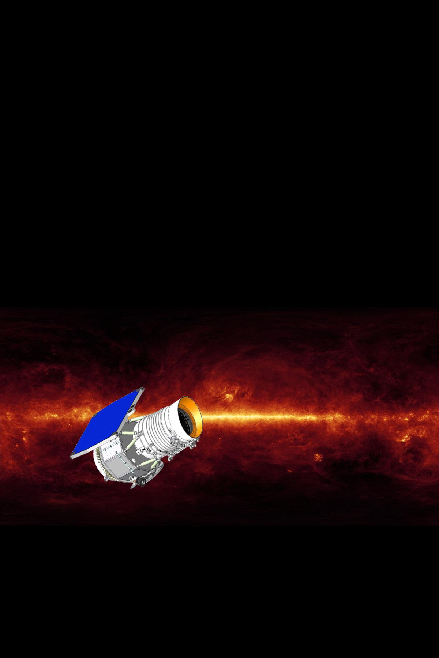
The prototype: W1814+3412
z=2.45
Eisenhardt+ 2012, ApJ 755, 173

Slide 4
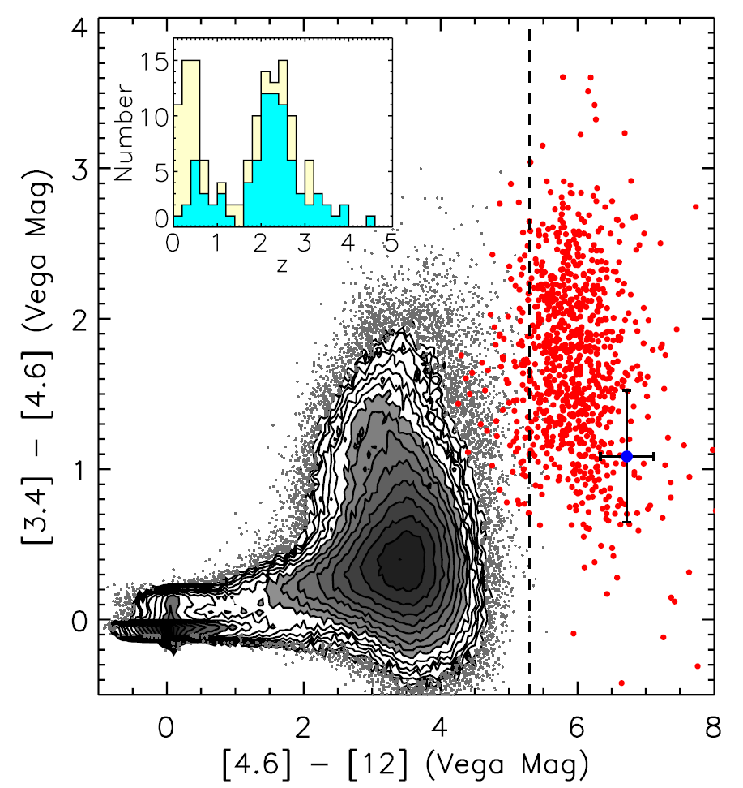
Red dots: hot DOGs
(all sky)
colours also from follow-up Spitzer data
The rest: a typical WISE sample (b>80°)
inset: redshift distribution
Eisenhardt+ 2012, ApJ 755, 173

Slide 5
Our current understanding of hot DOGs
Redshifts are typically high, with a distribution peaking
between 2 and 3
→ at the peak of cosmic star formation and AGN activity
Many spectra show signs of obscured AGN
Luminosities (~10¹³–10¹⁴ L) are comparable to the most luminous quasars
SEDs are different from other known populations, the high mid-IR/submm luminosity ratio indicates that the dominant emission comes from hot dust (60–120 K)
Extreme and rare cases of luminous DOGs, representing a short evolutionary phase in galaxy evolution through mergers
Starburst – AGN transitions?
Wu+ 2012, ApJ 756, 96; Wu+ 2014, ApJ 793, 8

Slide 6
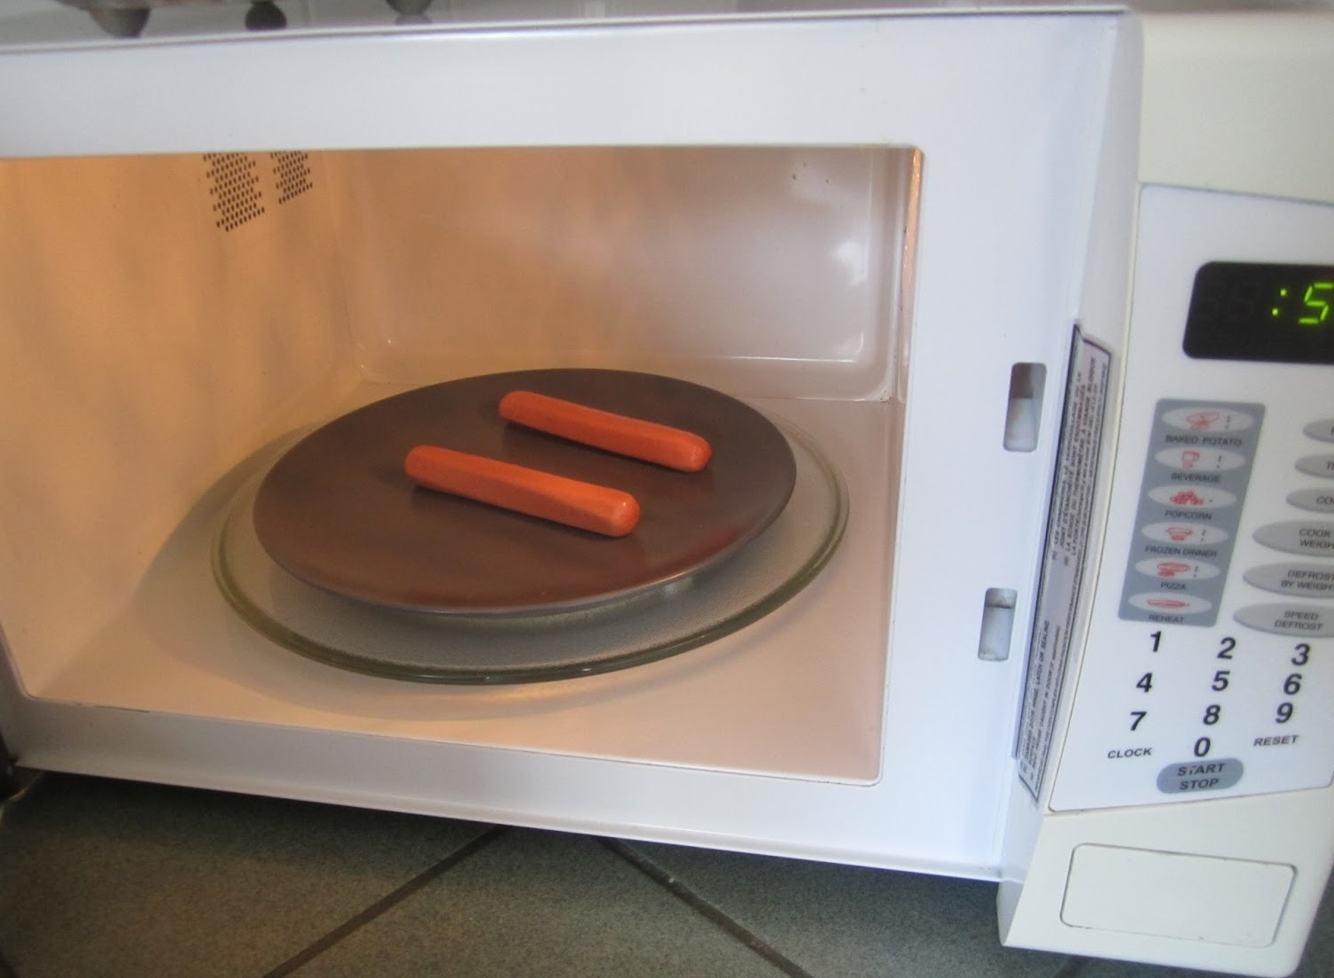
Hot DOGs in the microwave
Some of these WISE-selected objects show mJy-level radio emission at cm wavelenghts
VLBI has a unique capability to discriminate between the strarburst and AGN origin of the radio emission
VLBI detection → direct confirmation of radio AGN
If these sources really harbour young AGN, we may find compact symmetric structures (CSOs)
If their activity is triggered by mergers, we may see spatially resolved dual AGN sources

Slide 7
Test of the compact radio structures
Sensitive phase-referenced observations initiated with the EVN
Project: EF025
2014 Feb 21/22, total time 14 h
Observed in e-VLBI mode, but within the disk session
8 stations: Ef, Wb, Jb (Lovell), On, Mc, Nt, Tr, Sh
1.6 GHz frequency: higher chance of detection (presumably steep-spectrum sources)
Sources yet unexplored with VLBI → pilot project, with 4 targets

Slide 8
The EVN sample
Source designation | Redshift | Peak brightness (mJy/beam) | Flux density (mJy)
W0757+5113 | 2.227 | 3.19 | 3.57
W1146+4129 | 1.772 | 4.39 | 4.39
W1603+2745 | 2.633 | 1.77 | 2.28
W1814+3412 | 2.452 |  | ~1.2
Abby
Bella
Charlie
Daisy
A subsample from 26 hot DOGs
12 in the FIRST coverage, 3 with radio detection (>1 mJy)
+1 source (the “prototype”) with EVLA flux density data
Wu+ 2012, ApJ 756, 96
Eisenhardt+ 2012, ApJ 755, 173

Slide 9
Results
Four mJy-level targets, four detections! – albeit three (and especially two) of them are rather weak
The sources are all resolved on ~10-30 mas angular scales
VLBI phase-referencing provides the most accurate positional information available for these sources
Each one is different world – see the 1.6-GHz EVN images of Abby, Bella, Charlie, and Daisy:

Slide 10
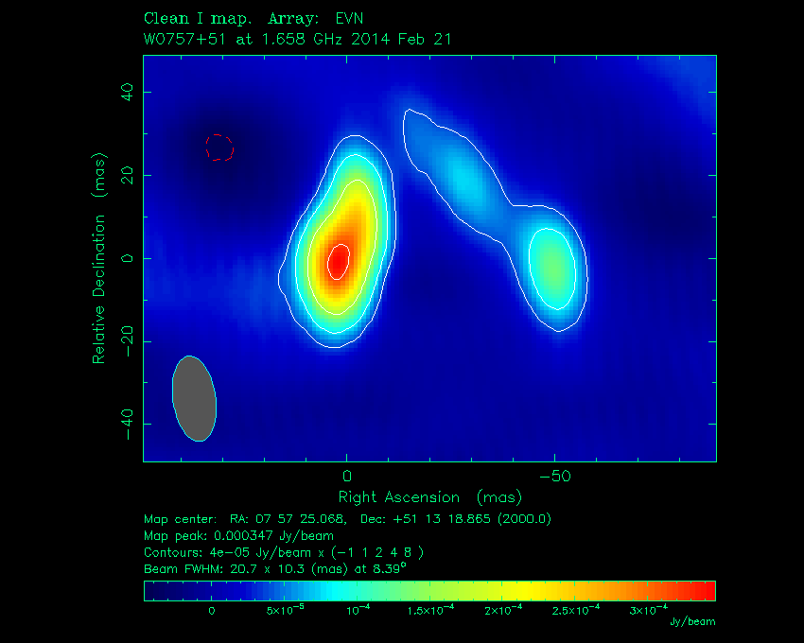
Abby
200 pc
0.9 mJy in the CLEAN components
(~25% of the FIRST flux density)

Slide 11
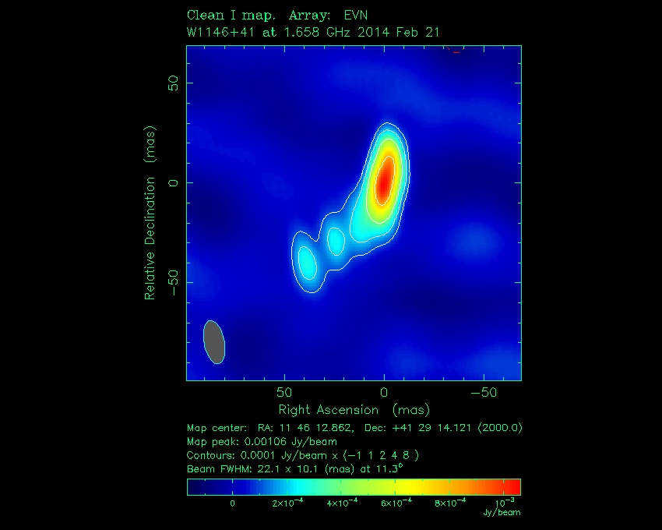
Bella
200 pc
3.1 mJy in the CLEAN components
(~70% of the FIRST flux density)
The most compact radio source in this sample

Slide 12
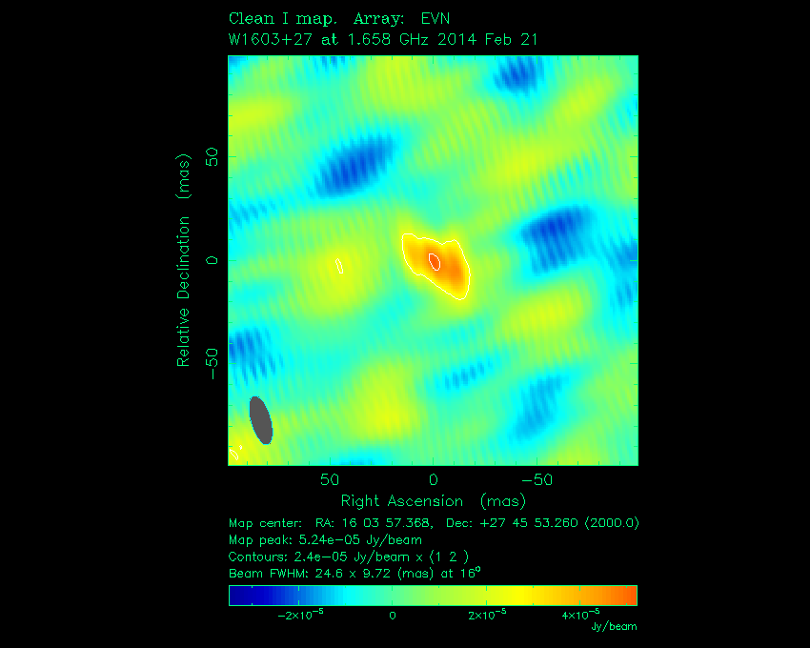
Charlie
200 pc
Just 0.15 mJy in the CLEAN components
(~7 % of the FIRST value)
a 7-σ detection

Slide 13
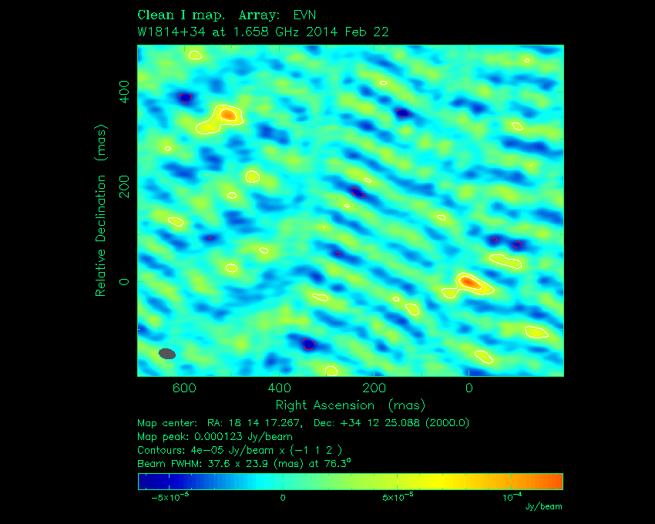
Daisy
~600 mas
4.9 kpc
0.36 mJy in two distinct sources
(~1/3 of the expected total flux density)

Slide 14
Summary & outlook
A small radio subsample, four hot DOGs were observed with the EVN at L band; all four were detected
In one of them (Bella, alias W1146+4129), most of the radio emission comes from a compact AGN
Three of them are very weak on ~10-mas scales; their radio emission must be dominated by startburst-related activity
Daisy, the prototype hot DOG (W1814+3412), has a symmetric double structure with nearly 5 kpc projected separation
Directions for the future:
Interpreting the results in the context of growing multi-band data
Targeting a larger sample of hot DOGs with known radio emission
Obtaining spectral information at 5 GHz (where feasible)

Slide 15
EVN’s

